Slide 1
Mockups

Slide 2
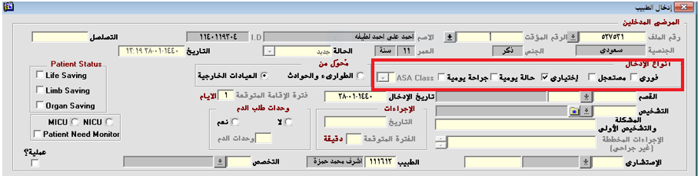
1. Add patient input types. Input Types: Immediate, Urgent, Optional, Daily Condition, Daily Surgery, ASA Class

Slide 3
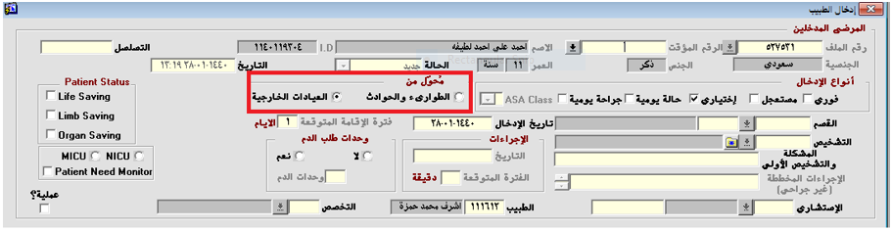
2. Outpatient and emergency referral or outpatient: In case of emergency referral, the type of hypnosis request is immediate and in the case of a referral from the clinic, it offers all options: (immediate, urgent, optional, daily, daily, ASA Class).

Slide 4
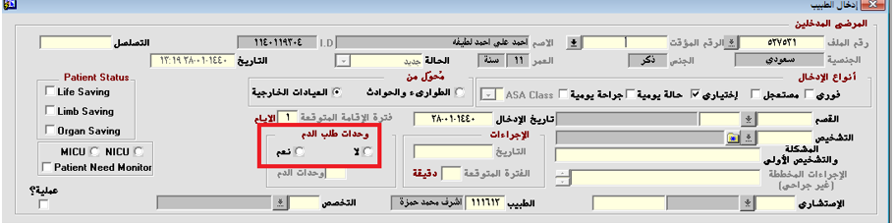
3. Add the required number of blood units field to be addressed by the blood bank system.
Blood request units: o No o Yes ------- Blood units

Slide 5
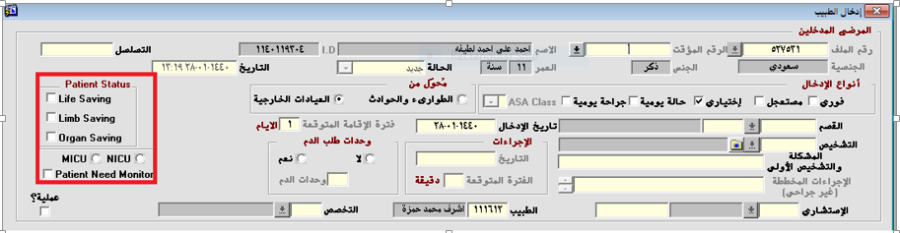
4. Adding a patient status option is entered in the hypnosis request and appears on the Hypnosis Receipt screen. Patient Status o Life Saving o Limb Saving o Organ Saving o MICU o NICU o Patient Need Monitor

Slide 6
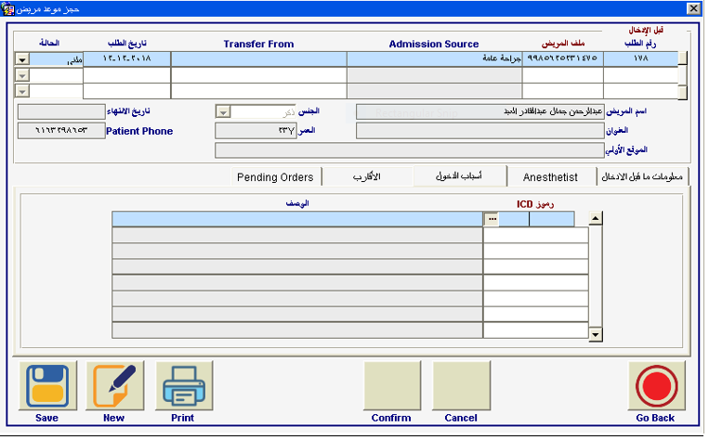
5. Add favorites to the diagnostic list so that the doctor can show a list of his favorite diagnoses

Slide 7
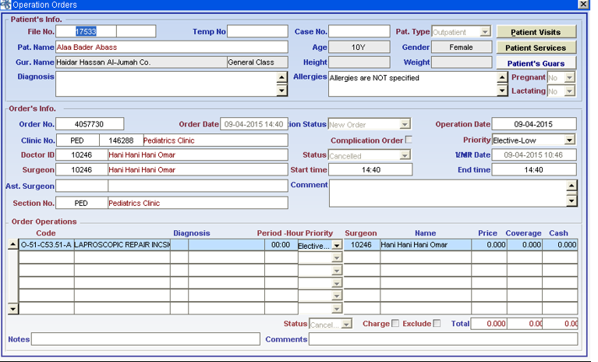
6. The surgical plan will be dealt with by the system of operations and doctors as there are many determinants of the duration of the operation and the number of hours of operation of the operating room by specialty

Slide 8

7. When the status of the request is new, the doctor can cancel the request, but after receiving the request by the hypnosis department, the request cannot be canceled through the hypnosis

Slide 9
8. The hypnosis request report is printed by the doctor after saving the information.

